Slide 1



AN ASSESSMENT OF TEXAS' GEOTHERMAL RESOURCES AND ECONOMIC POTENTIAL, 2012
University of Texas at Austin
Bureau of Economic Geology
Presentation for GSA Annual Meeting & Exposition
Charlotte, North Carolina
November 7, 3:00 PM
Presented by S Daniel Zafar
ACKNOWLEDGEMENTS:
This project is the result of work conducted within the
National Geothermal Database Development Project (NGDS), funded by the US Department of Energy and Directed by Dave Blackwell of SMU as well as the State of Texas Advanced Oil and Gas Resource Recovery (STARR) project also funded by the US DOE.
Current Project Researchers
-Bruce Cutright
-Adam Stater
-Tracy Terrall
-Shadiya Bello
-Kyle Kampa
-Kevin Meyer
-S Daniel Zafar

Slide 2
Motivation
Deloitte 2008 report found four barriers to market acceptance and application:
  Access to transmission infrastructure
  Lack of risk mitigation mechanisms available during early stages of development
  Lack of policy continuity and clarity
  Lack of reliable resource information
    Recommended the creation of a national geothermal database
NGDS
  Aims to provide baseline information for future developments of geothermal energy production.

Slide 3
Process
Assessment of Available Data
IGOR Database
RRC Database
Commercial Databases
(IHS, Drilling Info, etc.)
Legacy Publications
SMU Geothermal and Heat flow Databases
Data Organization, Correction, Presentation
Development of master spreadsheets
BHT Corrections
Temperature Gradient Calculations
Illustrative Contour Maps
Document Scanning
Data Analysis pertinent to Economics
Reservoir Characteristics
Net Sand Thicknesses
Isotherm Contour maps
Reservoir Volume
Well Flow parameters
Economic Production Factors

Slide 4
Models
GETEM Model
  Geothermal cost model produced by the DOE
  Takes into account flow rate, basic reservoir properties, life-cycle of equipment, and various development, exploration, and tax etc. costs.
  Outputs cost in ¢/kw-hr, ideal power generation capacity, and annual costs and revenues.
The Uddenberg (2012) Lumped Parameter Model
  Designed to provide a rough estimate of production and injection well schemes to ensure the long-term sustainability of the thermal properties of a prospective reservoir.
  Takes into account reservoir properties and distance between injection and production wells.
  Assesses whether the scheme is sustainable before GETEM modeling with the flow rates and temperatures used.

Slide 5
Use of Existing Wells
In Texas, the infrastructure for geothermal energy already exists in the form of pre-drilled wells, transmission lines, and resource-based knowledge.
This acts as “low hanging fruit” for potential geothermal operations in Texas by reducing the drilling costs.
Holes Plugged | 2011 | 2010 | 2009
Oil | 3,340 | 3,771 | 3,991
Gas | 1,827 | 1,750 | 1,916
Other | 394 | 493 | 464
Total | 5,564 | 6,028 | 6,390
From Texas RRC 2011 Drilling Summary:
http://www.rrc.state.tx.us/data/drilling/drillingsummary/2011/annual2011.pdf

Slide 6
Geothermal Resources of Texas

Slide 7
Geothermal Resources of Texas

Slide 8
The Gulf Coast
Lithology is dominated by succeeding growth-faulted tertiary sands.
Deep hot geopressured reservoirs present in the Wilcox, Frio, and Vicksburg formations
  These formations contain the best sedimentary thermal gradients in Texas, increasing to the SW.
Our analysis took place by field
  Data and analysis available to general public

Slide 9
The Gulf Coast

Slide 10
The Gulf Coast

Slide 11
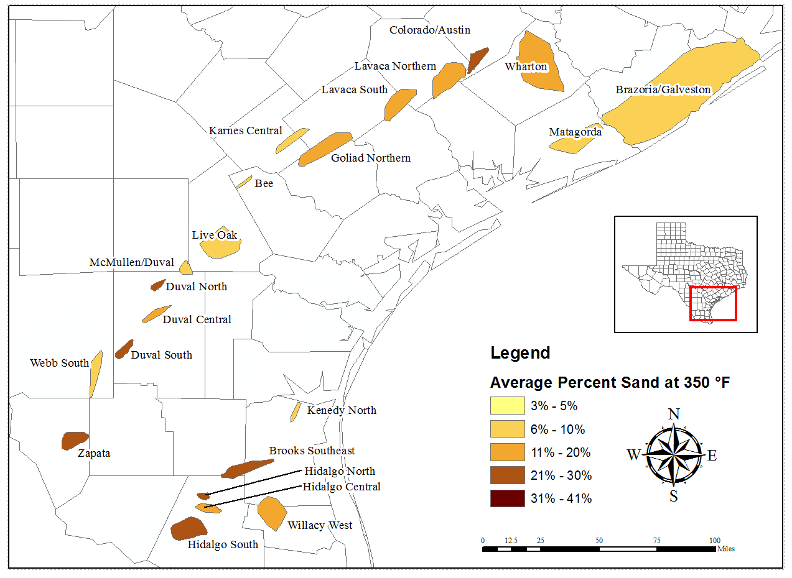
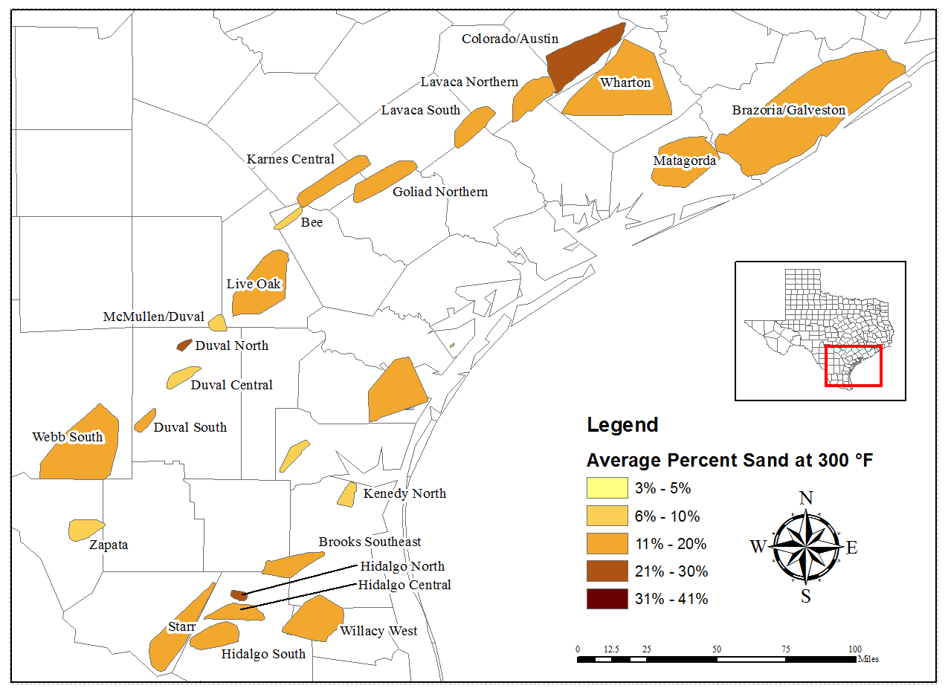
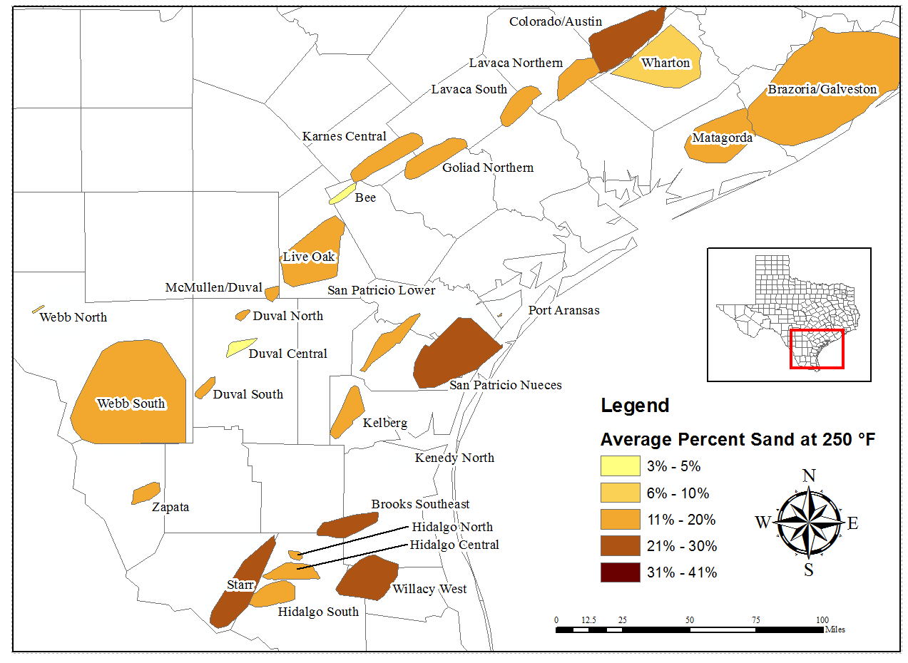
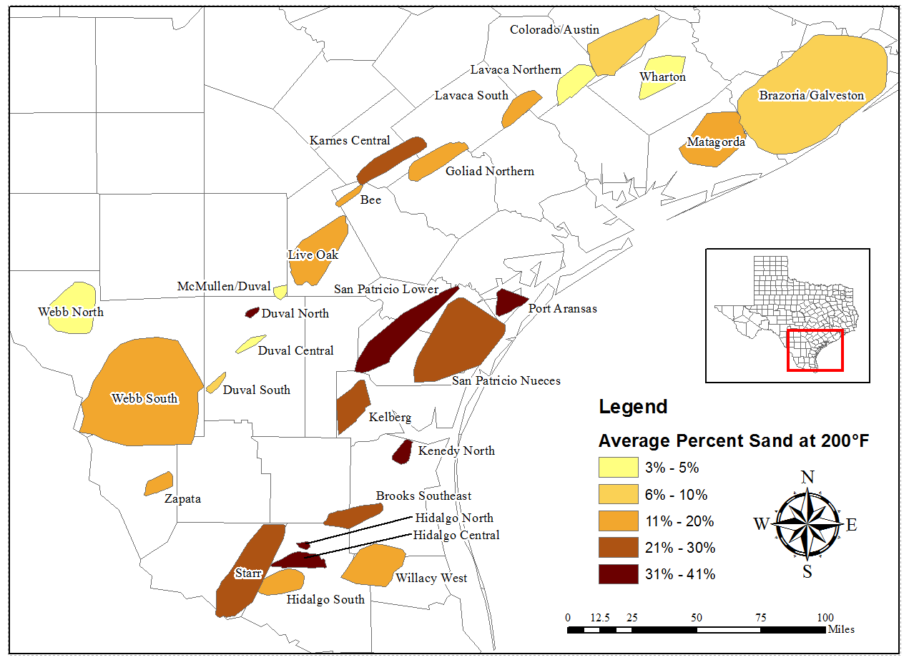
The Gulf Coast
Deep geopressured reservoirs.
Analysis of the Gulf field took place by isotherms of 200°F, 250°F, 300°F, and 350°F.

Slide 12
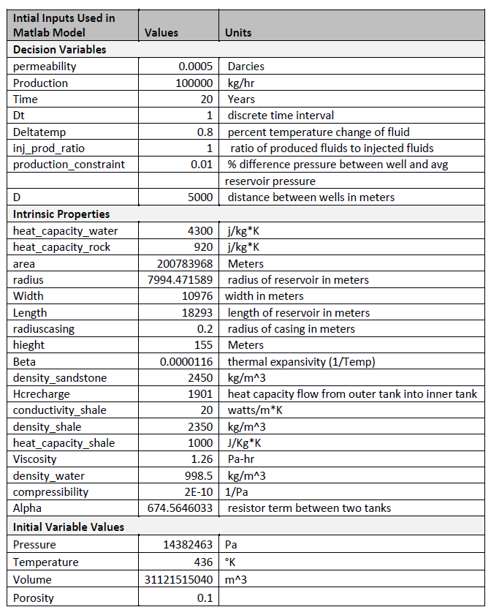
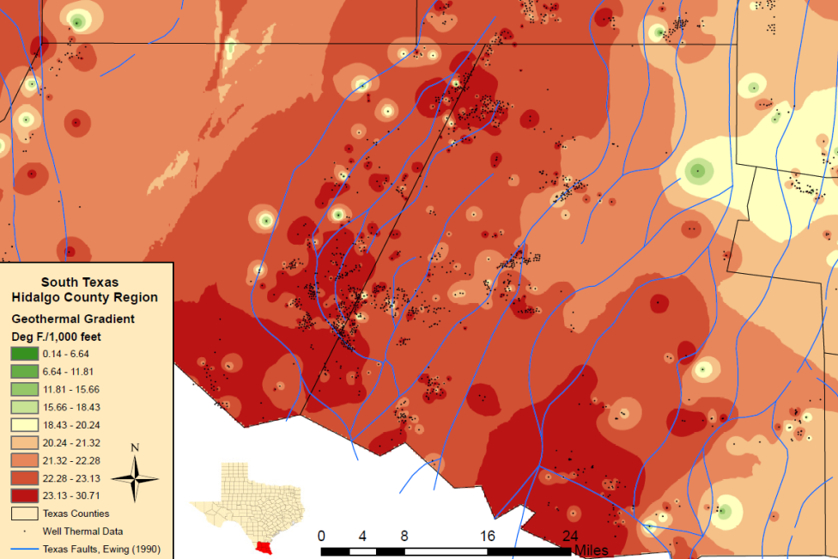
Hidalgo South Fairway
Parameter | LPM Model Results for next 20 years
Power Calculated | 1.3 MW
Cost Calculated | ¢6.2/kWhr
Annual Nominal Revenue Calculated | $706,000
Time to cover initial investment | 4-5 years

Slide 13
East Texas
Mostly limestone with permeable sandstone pockets
Extensive salt diapers with associated high thermal conductivity
Best gradients located near the Sabine Uplift and East Texas Diapir Province
Created reservoir database by formation
  Includes Upper Jurassic to Eocene formations
  Data and analysis available to general public

Slide 14
East Texas

Slide 15
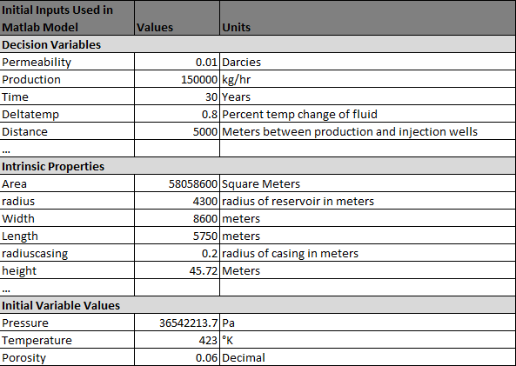
East Texas: Brachfield SE Field, Rusk County
Parameter | LPM Model Results for next 20 years
Optimal Power Calculated | 6.9 MW
Cost Calculated | ¢7.0/kWhr
Annual Nominal Revenue Calculated | $7,885,500
Time to cover initial investment | <4 years

Slide 16
Future Work: Anadarko Basin & East Texas Data Analysis
Well data has been retrieved, but analysis is not yet completed.
Preliminary Results: Temperature-depth maps.

Slide 17
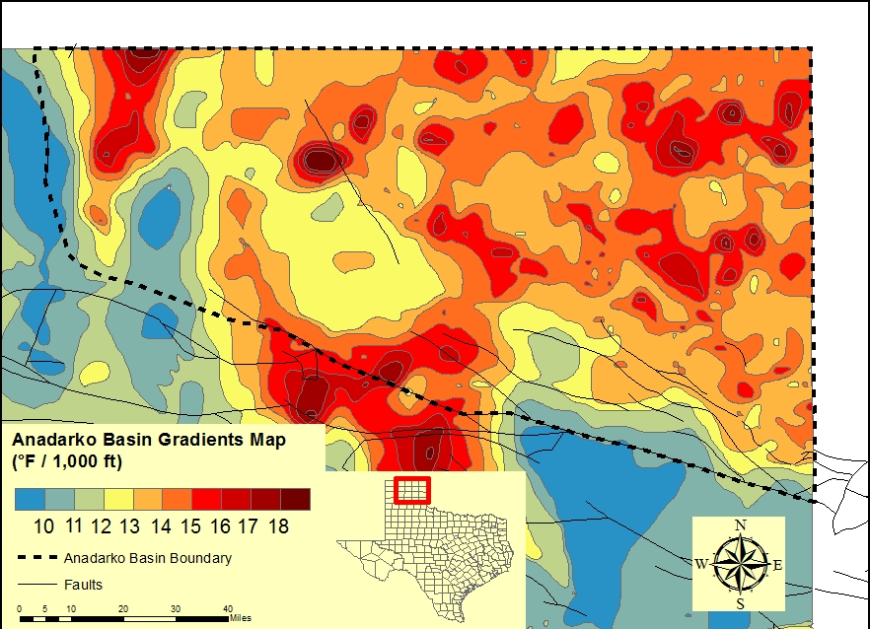
The Anadarko Basin

Slide 18
West Texas

Slide 19
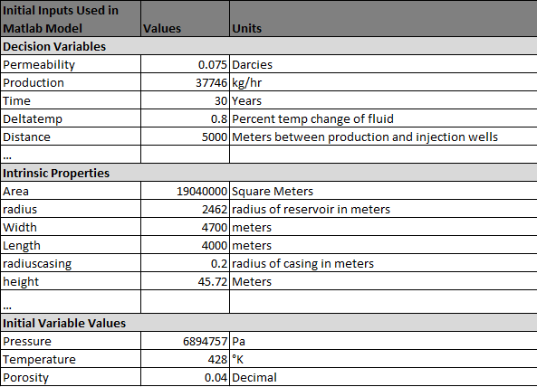
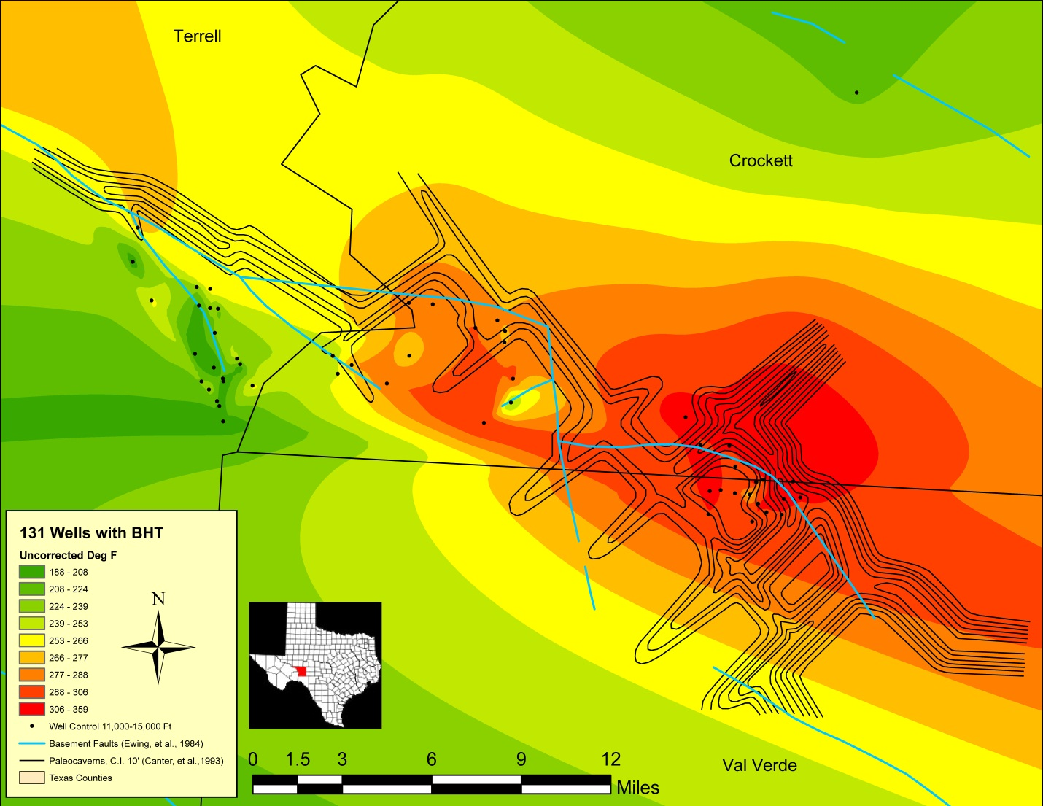
West Texas: Will O Field, Crockett County
Parameter | LPM Model Results for next 20 years
Optimal Power Calculated | 8.04 MW
Cost Calculated | ¢8.24/kWhr
Annual Nominal Revenue Calculated | $9,120,000
Time to cover initial investment | 4- 4.5 years

Slide 20
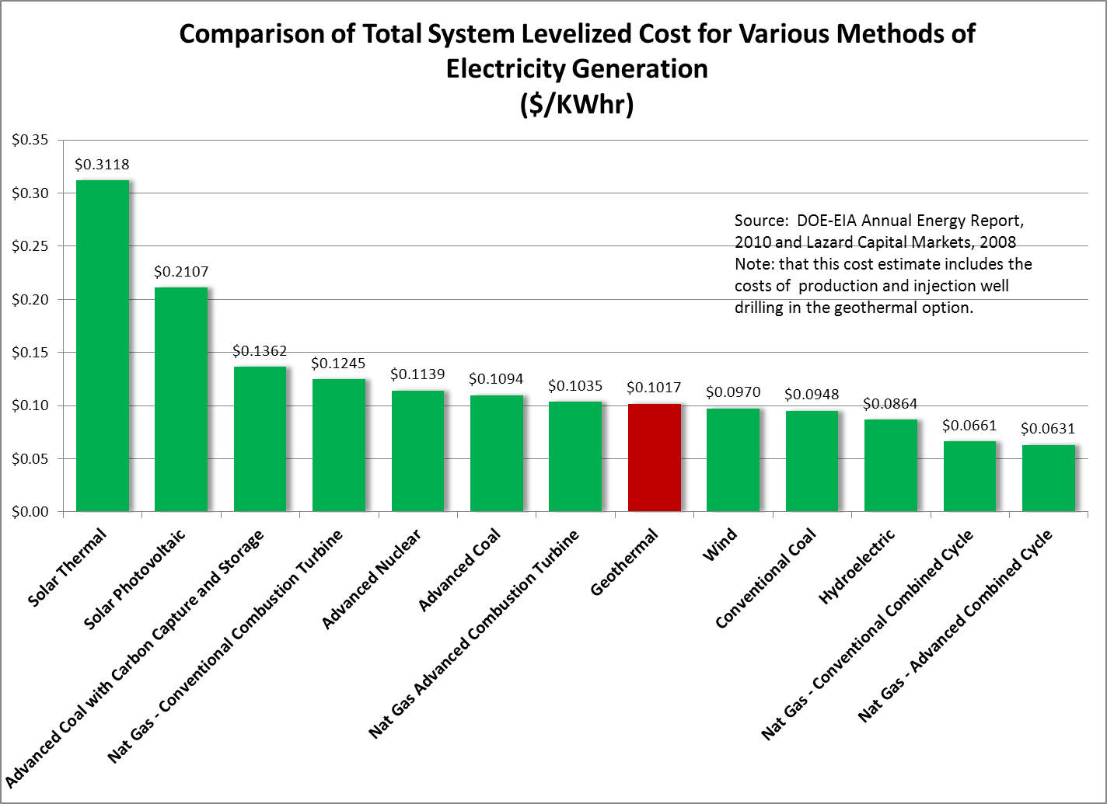
Conclusion
Site/Field | Modeled Cost
Hidalgo | ¢6.2/kWhr
Brachfield SE | ¢7.0/kWhr
Will O | ¢8.24/kWhr
Well data has been retrieved, but analysis is not yet completed.
Preliminary Results: Temperature-depth maps.

Slide 21
Thank You!
Contact at:
SDanielZafar@utexas.edu
Questions?

Slide 22
Outline
Motivation
Texas’ Geothermal History
The Binary Cycle Turbine & Double Pipe Heat Exchanger
Process & Data
The Uddenberg (2012) Lumped Parameter Model
Texas Resources
  Gulf Texas
  East Texas
  Anadarko Basin
  West Texas
Conclusion

Slide 23
History of Geothermal in Texas
Mid 1970s - Gulf Coast geothermal/geopressure
  Loucks and Bebout
1982 – First Geothermal Resource of Texas Evaluation
  Woodruff
2004 – Deloitte report
2006 – MIT Future of Geothermal report
2010 – Blackwell & Richards East I-35 SECO report
2011 – Augustine & Espidido

Slide 24
Data Sources

Slide 25
Gradient Tiling
Identify area of interest based on BHT, BHP, gradient, water flow and well density.
Correct BHT using SMU-Harrison correction.
Plot BHT vs Depth to identify outliers and general thermal regime of the target area.
Best fit line, typically linear or polynomial with intercept at 70 (mean surface temp. reported by NOAA), and R² help determine thermal trends.
Create histogram of geothermal gradients for target area and analyze distribution.
Assumption that BHTs are minimum temperature measurements and if the distribution has a rapid drop in frequency then we can claim data are approaching “true” geothermal gradient of target area.
Identify a representative regional gradient and generate isothermal surfaces for well log analysis.

Slide 26
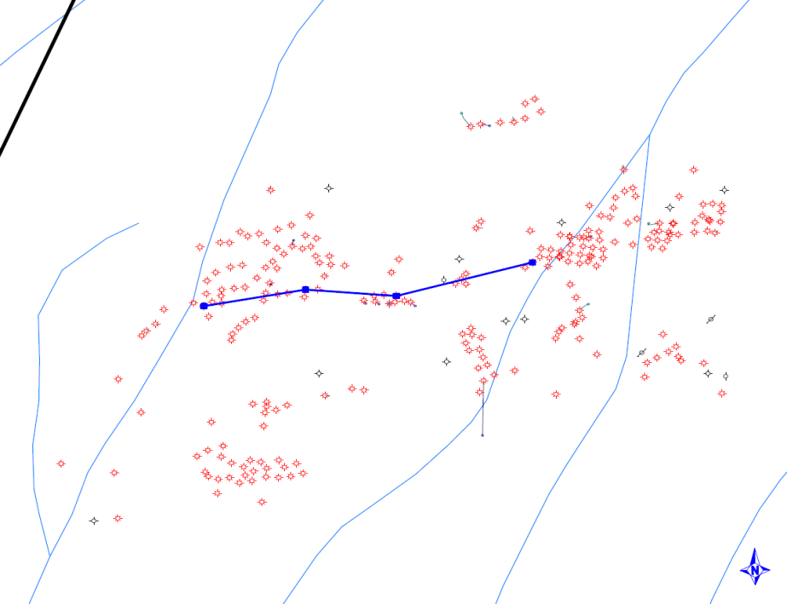
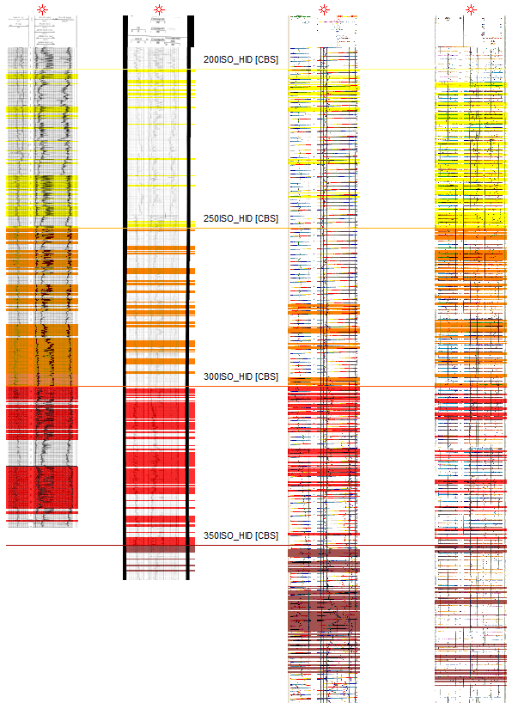
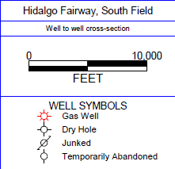
Well Log Interpretation
Well to well cross section
Based on the gradient tiling assessment, 200˚, 250˚, 300˚, and 350˚ Fahrenheit isotherms are imported into Petra.
Sections of low Gamma Ray and SP are used to define sand sections.
The sand intervals are then summed to create a sand thickness map between isotherms.
5,447 ft.
200 Degree Surface
7,769 ft.
250 Degree Surface
10,257 ft.
300 Degree Surface
12,955 ft.
350 Degree Surface

Slide 27
GETEM Model Inputs
Economic Parameters
  Project life, utilization factor, contingency, royalties, discount rate, tax rate, duration of phases of development, inflation, and depreciation schedules.
Resource Definition
  Geothermal resource type, temperature, and depth.
Resource Exploration
  Pre-drilling costs (exploration wells, permitting costs, lease costs, etc.)
Resource Confirmation
  Success ratio, wells required, permitting costs, stimulation, well tests.
Well Field Development
  Drilling success rate, production/injection wells, drilling and well costs.
Reservoir Definition
  Flow rate, stimulation, hydraulic drawdown, permeability, dimensions, water loss.
Geothermal Fluid Pumping
  Production well pumping, injection well pumping, efficiency.
O&M costs

